Slide 1
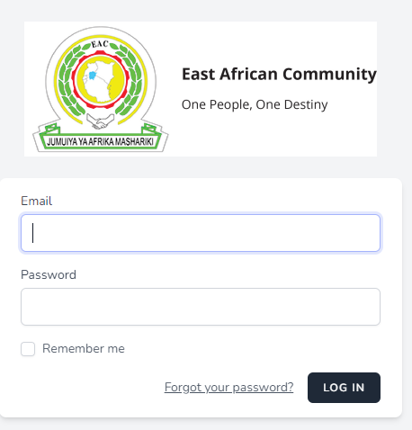
Login

Slide 2
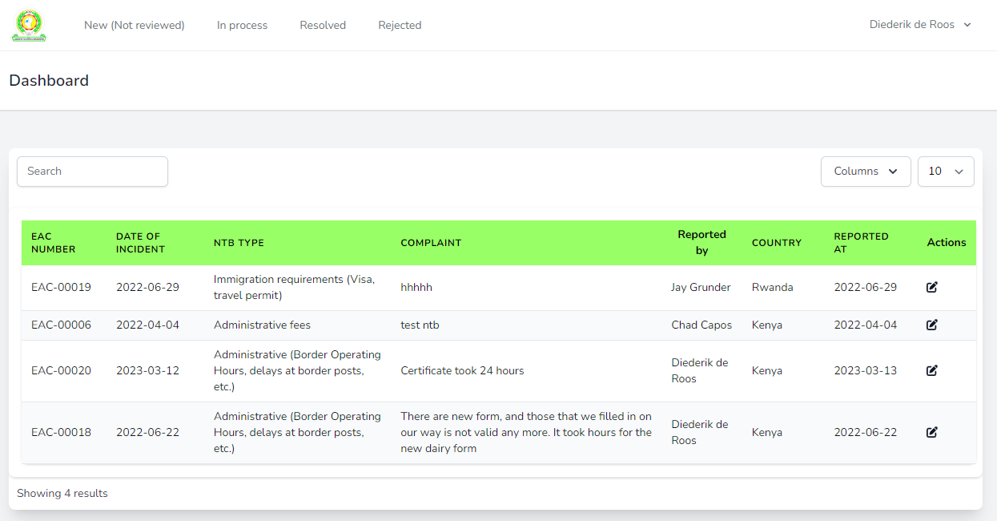
Dashboard showing all NEW

Slide 3
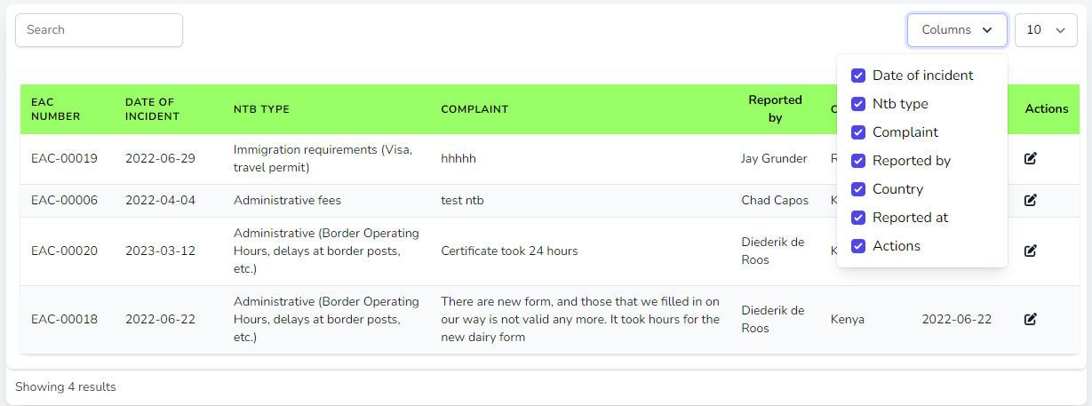
Columns can be de-selected to change the view

Slide 4
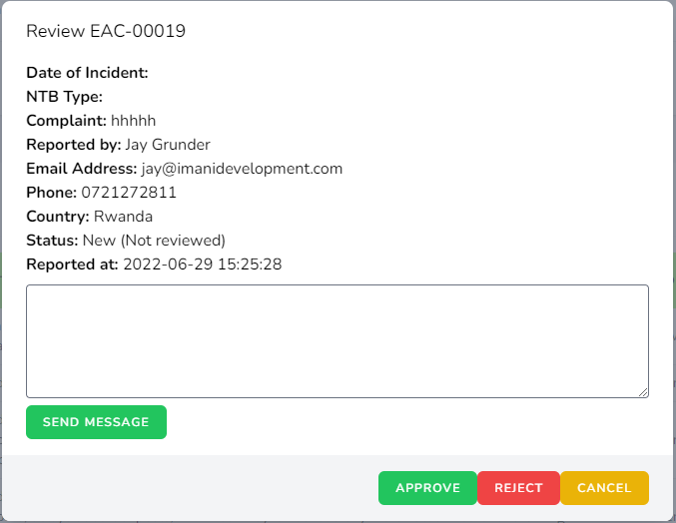
Pop-up after clicking “Edit” Action

Slide 5
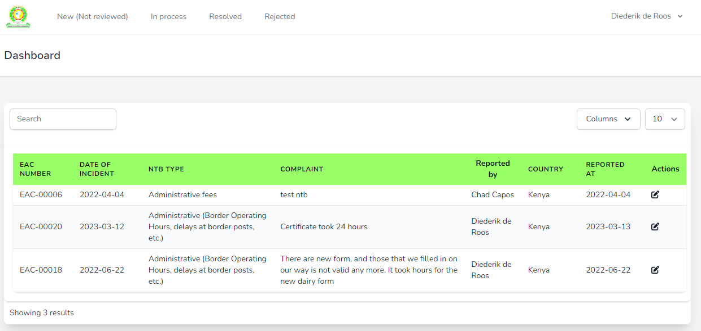
After clicking “Approve” button NTB not listed under NEW anymore

Slide 6
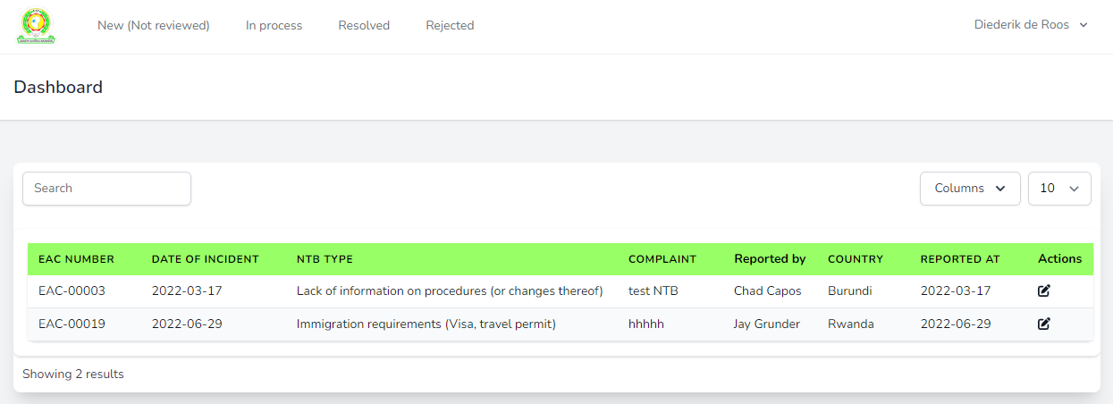
Approved NTB listed under heading “In process”

Slide 7
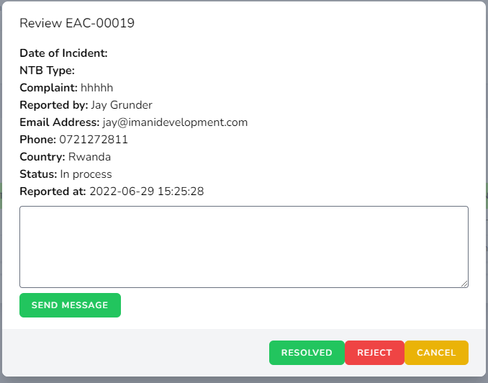
In process NTB provides option to Reject or Resolve

Slide 8
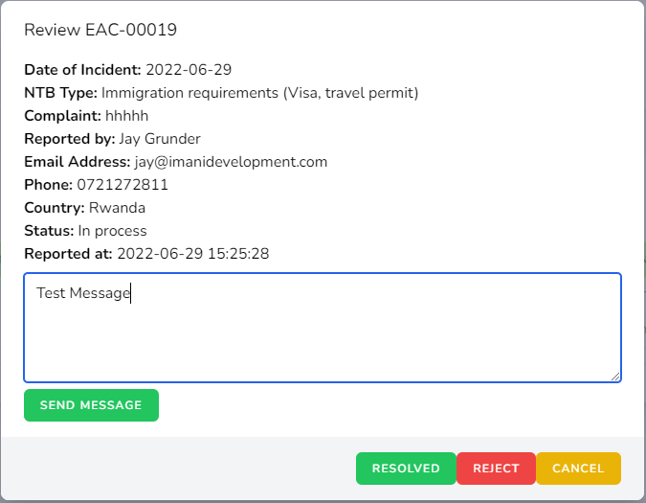
In process NTB provides option to send a message

Slide 9
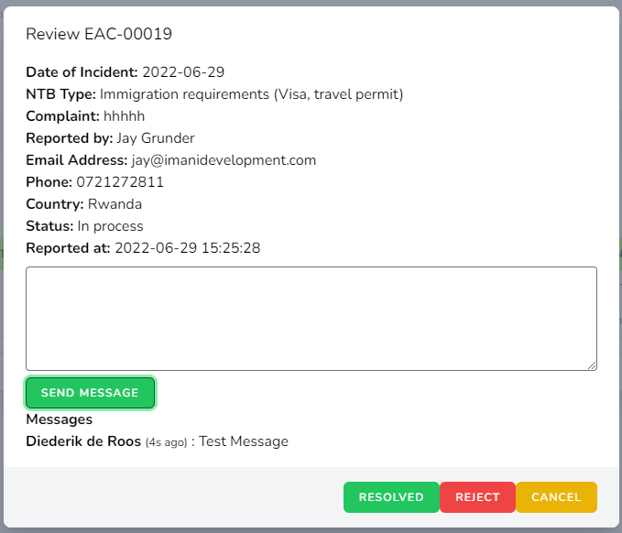
Sent Message shown below NTB

Slide 10
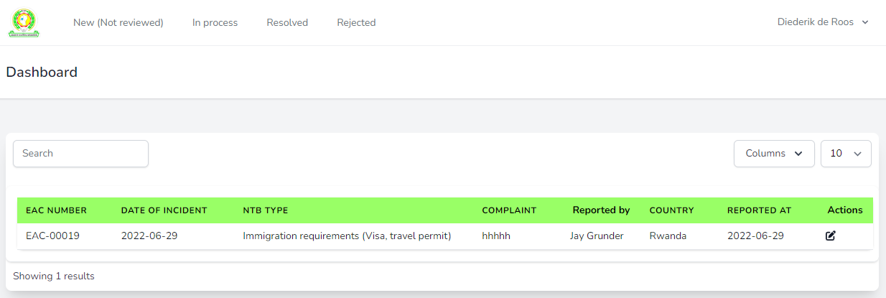
Resolved NTB listed under heading “Resolved”

Slide 11
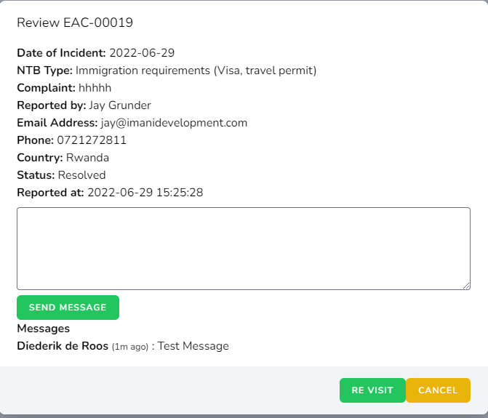
Option available now to “Re visit” or change the status

Slide 12
NTB listed once more under heading “In process”

Slide 13
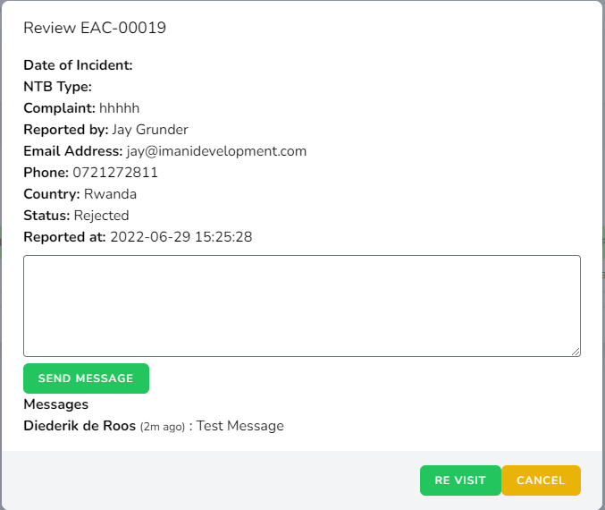
Same process applies for rejected NTBs:

Slide 14
Options for admin user

