Slide 1
EAC NTB Reporting App
for The EAC
Prepared by
Project Component C: Development of an integrated EAC Wide NTB SMS/online reporting and monitoring mechanism (An NTB Reporting APP)

Slide 2
Process Flow for NTB Monitoring App
User logs NTB complaint on EAC Mobile APP
Complaint and user details are sent to EAC NTB Exchange
EAC NTB Exchange
EAC Admin
User logs in
Users
EAC Complaints
EAC complaint declined or approved by EAC Admin
Status updated on EAC Mobile APP
Declined
Approved
Approved EAC complaint sent to Tripartite NTB System
Tripartite NTB System
All Approved Complaints

Slide 3
Steps for reporting an NTB, its Classification, and its Monitoring
Economic operator lodges a complaint/report order using an app. It would be structured to allow an administrator to classify the NTB in detail. The report order or complaint will be in a fixed format:
System Administrator (SA) receives the report order from the app. SA may contact the complainant to seek clarification if need be.
SA uploads information onto the EAC section of the NTB RMM using a front-end developed for this purpose with the following format:
Reporting a NTB – to be completed by the System Administrator
1 | Name of System Administrator
2 | Name of the original Reporter
3 | Border Post or location
4 | Date of reported incident
5 | Type of Economic Operator
6 | Gender
7 | Brief description of the NTB encountered
8 | Classification of the NTB for ‘other’ category only (link to training)
9 | Is the procedural obstacle (PO) administrative, regulatory or capacity? (the training will train the SA on how to determine the nature of PO)
10 | How much time was reported as being lost as a result of this incident?
12 | How much money did the Reporter estimate he/she lost as a result of this incident
Reporting a NTB – to be completed by the complainant as part of pre-screening questions
1 | Name of Reporter:
2* | Border Post or location
3* | Date of reported incident
4* | Contact number (required so that the incident can be verified)
5* | What type of economic operator are you? (Note that there will be a drop-down menu for the economic operator to select from)
6* | What is your gender?
7* | Brief description of the NTB encountered (no more than 100 words).
8* | How often has this happened to you in the last 12 months?
9* | How much time have you lost as a result of this incident
10* | How much money have you lost as a result of this incident

Slide 4
Steps for reporting an NTB, its Classification, and its Monitoring [Continued]
Once the System Administrator has uploaded the NTB onto the tradebarriers database he/she will notify the appropriate National Monitoring Committee(s).
If the complaint is indeed deemed an actionable NTB, the NMCs will start the process of removal by contacting the appropriate agencies or government departments and requesting an explanation for the NTB and details of the actions to be taken, and over what period, for the removal of the NTB. This will all be recorded on the NTB system.
Finally, for monitoring and analysis purposes, the improved tradebarrier,org’s dashboard (already discussed) will generate standard statistics and present them graphically (such as in histograms or bar charts or pie charts). The data that will be presented in the dashboard will include:
Frequency of occurrence of NTBs over a specific time period by category
Frequency of occurrence of NTBs over a specific time period by sub-category
Frequency of occurrence of NTBs by border (not always provided by complainants)
Time taken to eliminate NTBs by classification of NTBs

Slide 5
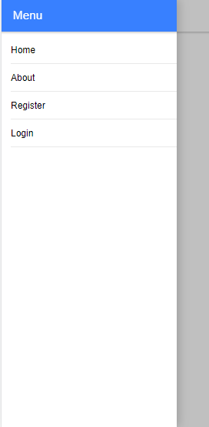
Downloading the App and its Home Page
The App will be available on the iStore and Play Store for free download
Once downloaded the user will open the app and be taken to the home screen
They can then click the about button to learn what the app is about and what its purpose is

Slide 6
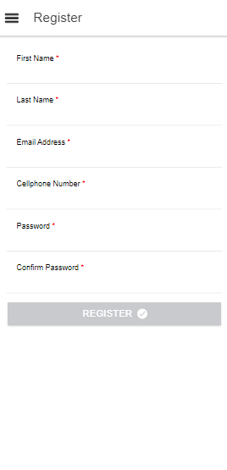
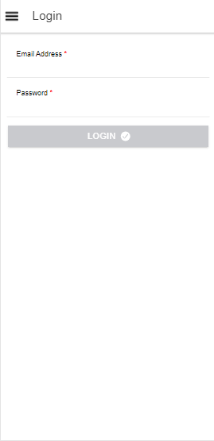
Registering and logging in
If they decide the app is what they are looking for they can then register and become registered users with a basic profile and a record of the complaints they have made
To access there logged complaints and make new complaints the users will just need to open the app, login, and then make a compliant.

Slide 7
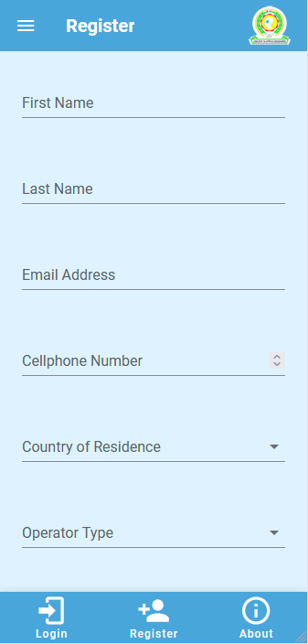
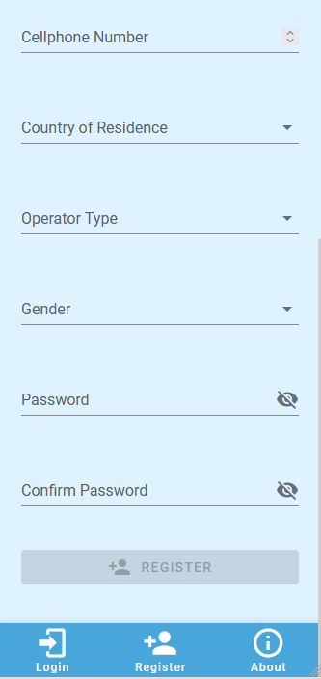
How to use the NTB RME Phone App
Register, to use the App at http://eac-mobile.portal.africa
The user will see the following screen:

Slide 8
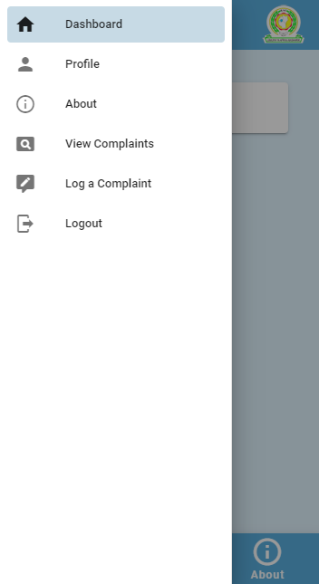
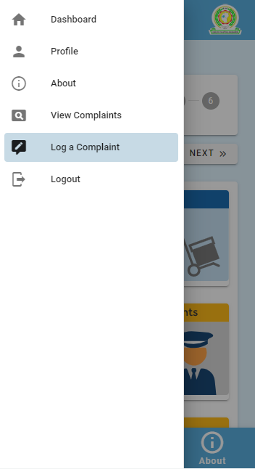
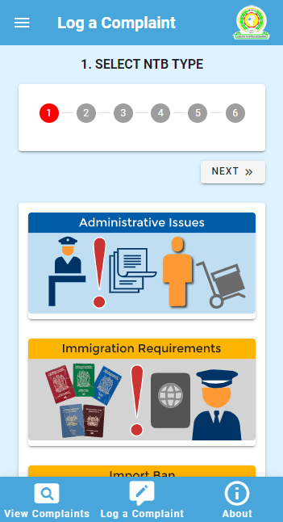
App Dashboard and Making a Complaint
Once the user is logged on they will go to the Dashboard
The Dashboard allows the user to see the complaint they have just made and the previous complaints they have made and their status
To make a complaint the user simply needs to click the log complaint button and follow the prompts

Slide 9
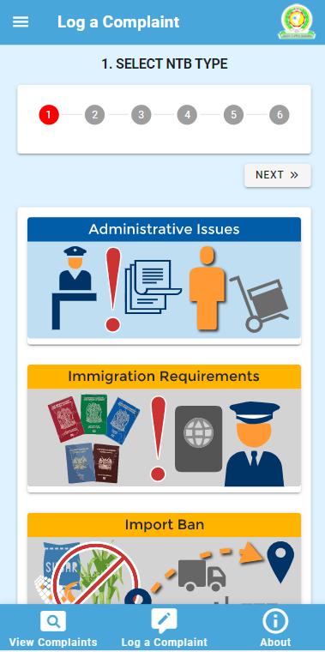
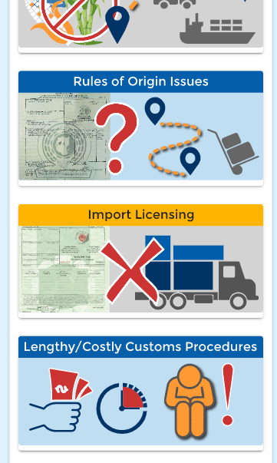
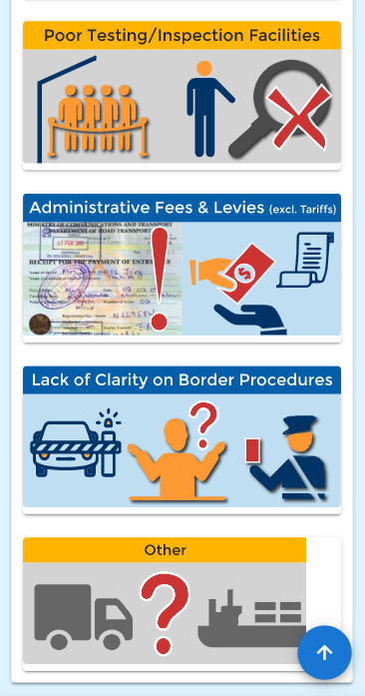
How to use the NTB RME Phone App
Once you select “log complaint,” the App will show the 9 most common NTBs pictorially. For step 1, the Affected Party needs to pick one, or select the category for “other”

Slide 10
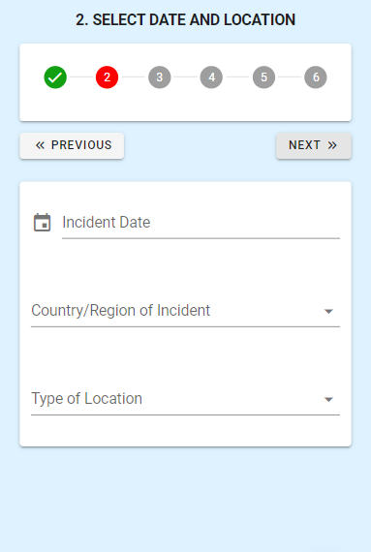
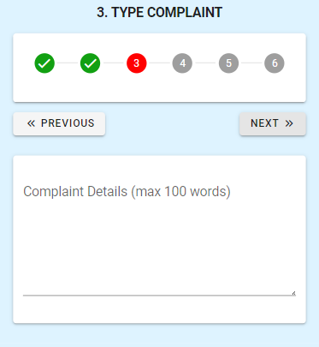
How to use the NTB RME Phone App
Affected Party completes the questions related to the NTB he or she has reported
Once the NTB has been selected, the reporter will go to the step 2 where they will fill out the date and the location of the incident
In step 3 there will be a box for the reporter to provide details for the complaint (maximum 100 words). This will be especially important for identifying the NTB in cases where the user selected the category “other” in step 1

Slide 11
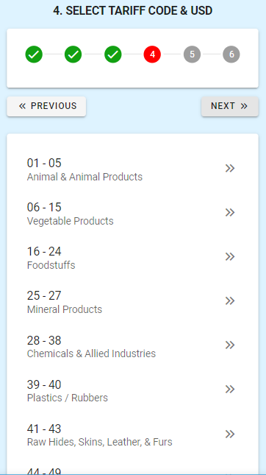
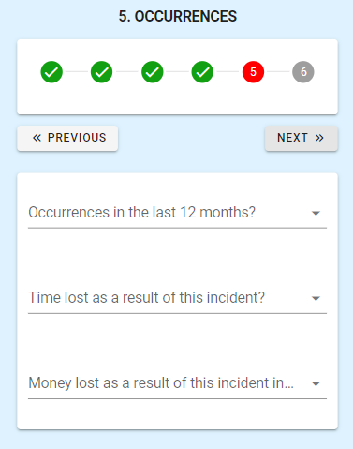
How to use the NTB RME Phone App
Affected Party completes the questions related to the NTB he or she has reported
The next step will be to select the type of goods that are affected by the NTB, and provide the estimated value of the consignment in question
Finally, there is an option in step 5 to capture additional data. This includes questions such as whether the NTB is recurring, how much time was lost as result, and how much money the reporter lost as a result of the incident

Slide 12
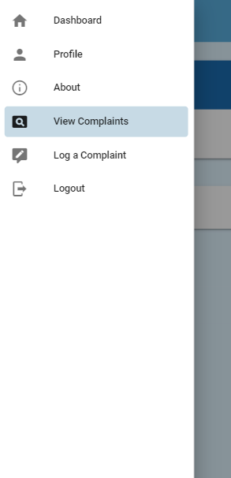
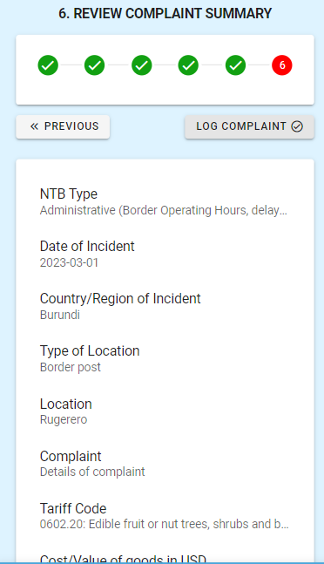
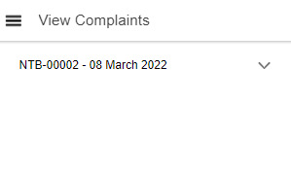
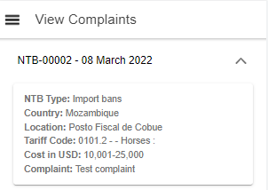
Summary of Complaint
Finally, at the end of the complaint logging process the user is shown a summary of their complaint on one screen
The user can access the claims they made in the past through the dashboard and learn what their status is as well.

Slide 13
EAC NTB Reporting App
for The EAC
Prepared by
Thank you

